Slide 1
TESTBED2 Secondees
Partner name: BEIA Consult International
Presenter: Robert Alfred Kecs
Date 09.01.2023

Slide 2
Secondees BEIA – TESTBED2
Suciu Gheorghe Sr.
Constantin Claudia
Iordache George Valentin
Sachian Mari-Anais
Kecs Robert Alfred
Goga Nicolae

Slide 3
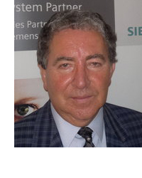
Dr. Ing. Suciu Gheorghe Sr.
Education:
B.S from ETTI , Polytechnic University of Bucharest
MBA from TEMIC Institute of Canada
Researcher CS III and Electronic Engineer
Secondments:
Amsterdam CWI (September-November 2022)
Durham University (June-September 2022)

Slide 4
Academic Experience
Specializations in project management, electronics and telecommunication, telemetry, ERP, cloud computing, M2M/IoT, Big Data acquisition, signal processing and blockchain.
Experience in coordinating, participating and evaluating more than 30 R&D projects (FP7, H2020, Eureka, COST, AAL, LIFE+, Interreg, etc.)
More than 35 years activity in ICT.
General Manager and founder of BEIA Consult
Founders of several start-ups
Defined role and tasks
Identify business cases
Analyze the key management and authentication for the SG
Support dissemination
Summer School Durham 7-8 June
Helped with WP5&WP2

Slide 5
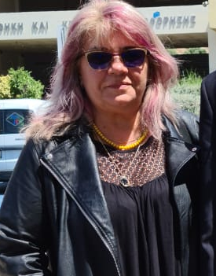
Dr. Ec. Constantin Claudia
Education:
B.S. of Finance and Banking degree at Artifex University
M.S. of Financial Banking and Insurance Management at Artifex University
Post-secondary management accounting courses at Spiru Haret College
Secondments:
Amsterdam CWI (September-November 2022)
Durham University (June-September 2022)

Slide 6
.
Business-wise considerations on key management related work
Input top rerequisites and assumption sin the key management architecture
Exploitation and costs calculations
Helped with WP5&WP2
She also participated in the Summer School Durham on 7th and 8th June - Smart Energy and Decarbonization.
The work in the secondments carried out was dedicated to WP2, we tried analysis in key management and authentication for SG and explored proposed solutions to merge schemes and perform joint processing where possible.
We discussed and analyzed the requirements defined in Task 2.1. Also, we analyzed, whether the declared requirements are clear, are complete, not ambiguous or not contradictory to the business scenarios. The attendant partners presented the project progress and the future goals.
We plan to continue our collaboration, by writing a paper describing the results of our research. We plan to work closely together, by organizing regular teleconferences, discuss issues and exchange thoughts.

Slide 7
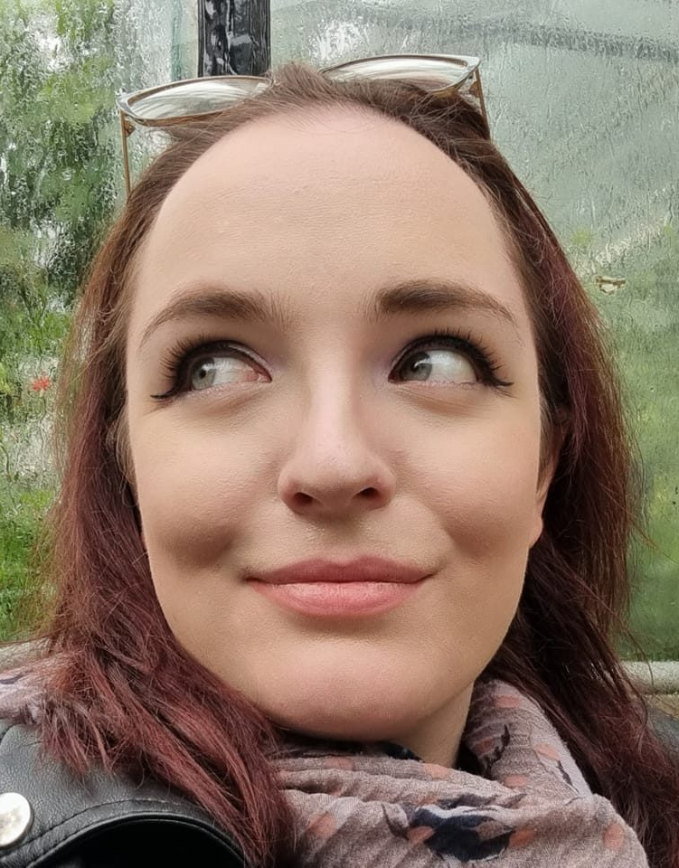
Ing. Sachian Mari-Anais
Education:
Polytechnic University of Bucharest
B.S.E. Electronics and Telecommunications
M.S.E. Micro and Nano Electronics
Secondments:
Durham University, UK,
(October 2022 – December 2022)
Amsterdam CWI , NTH
(April 2022 - June 2022)

Slide 8
.
Academic experience
Eng. Sachian Mari-Anais is a Research and Development Engineer in Cyber Security at BEIA CONSULT INTERNATIONAL.
Main technologies: Cyber Physical Security, Embedded Programming, Blockchain Technology, IoT, Tellecomunications;
Involved in Proposal writing for following research programs:
H2020
ITEA
EUREKA
CELTIC
Coauthor of over 20 articles in BDI journals.
More than 5 years of experience in research activity.
Involved in following European projects: SAFECARE, TOR-SIM, ODSI, STACK, UPSIM, SCRATCH, ENTA, I-DELTA, SealedGRID, FLEXI-CROSS, RITHM, CHRISS, S4ALLCITIES

Slide 9
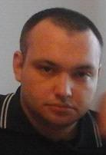
Dr.Ing George Valentin Iordache
Education: Polytechnic University of Bucharest
B.S.E. Electronics and Telecommunications
M.S.E. Micro and Nano Electronics
Secondment:
Amsterdam CWI , NTH
(April 2022 - June 2022)

Slide 10
Academic Experience
Specializations in blockchain, programing, cloud computing.
More than 15 years of experience in research activity.
He helped in the writing of over 20 articles.
He participated in the following European research projects: S4ALLCITIES, ESTABLISH, SEALEDGRID, MAD@WORK, HUBCAB, VITAL-5G

Slide 11
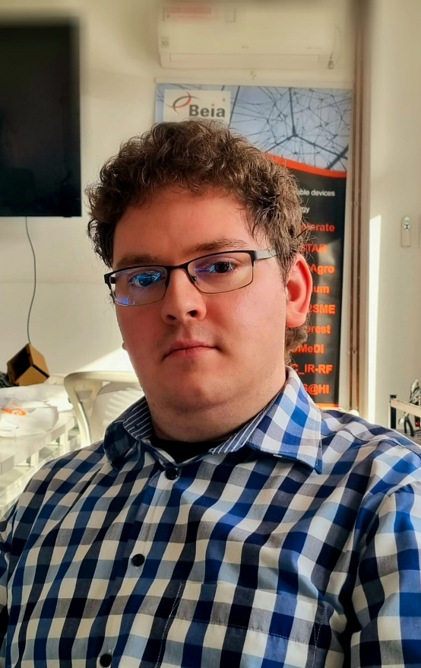
Ing. Kecs Robert Alfred
Education:
Polytechnic University of Bucharest
B.S.E. Electronics and Telecommunications
M.S.E. Micro and Nano Electronics
Secondment:
Durham University, UK
(October 2022 – December 2022)

Slide 12
Academic Experience
Specializations in electronics and telecommunication, telemetry, IoT, Big Data acquisition, signal processing and blockchain, programing.
More than 2 years of experience in research activity.
Involved in Proposal writing for following research programs:
H2020
EUREKA
Involved in following European projects: SAFECARE, Vital-5G, Toilet4me2, Farmsustainable, Smartsense, Disavit, SWAM, MIHA, SealedGRID.

Slide 13
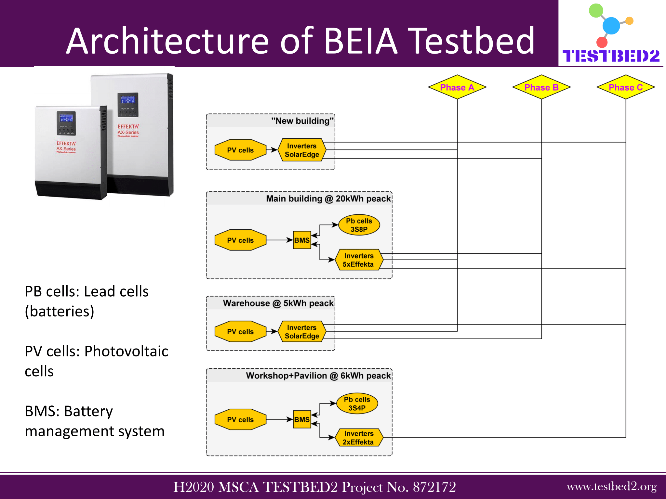
Conclusions

Slide 14
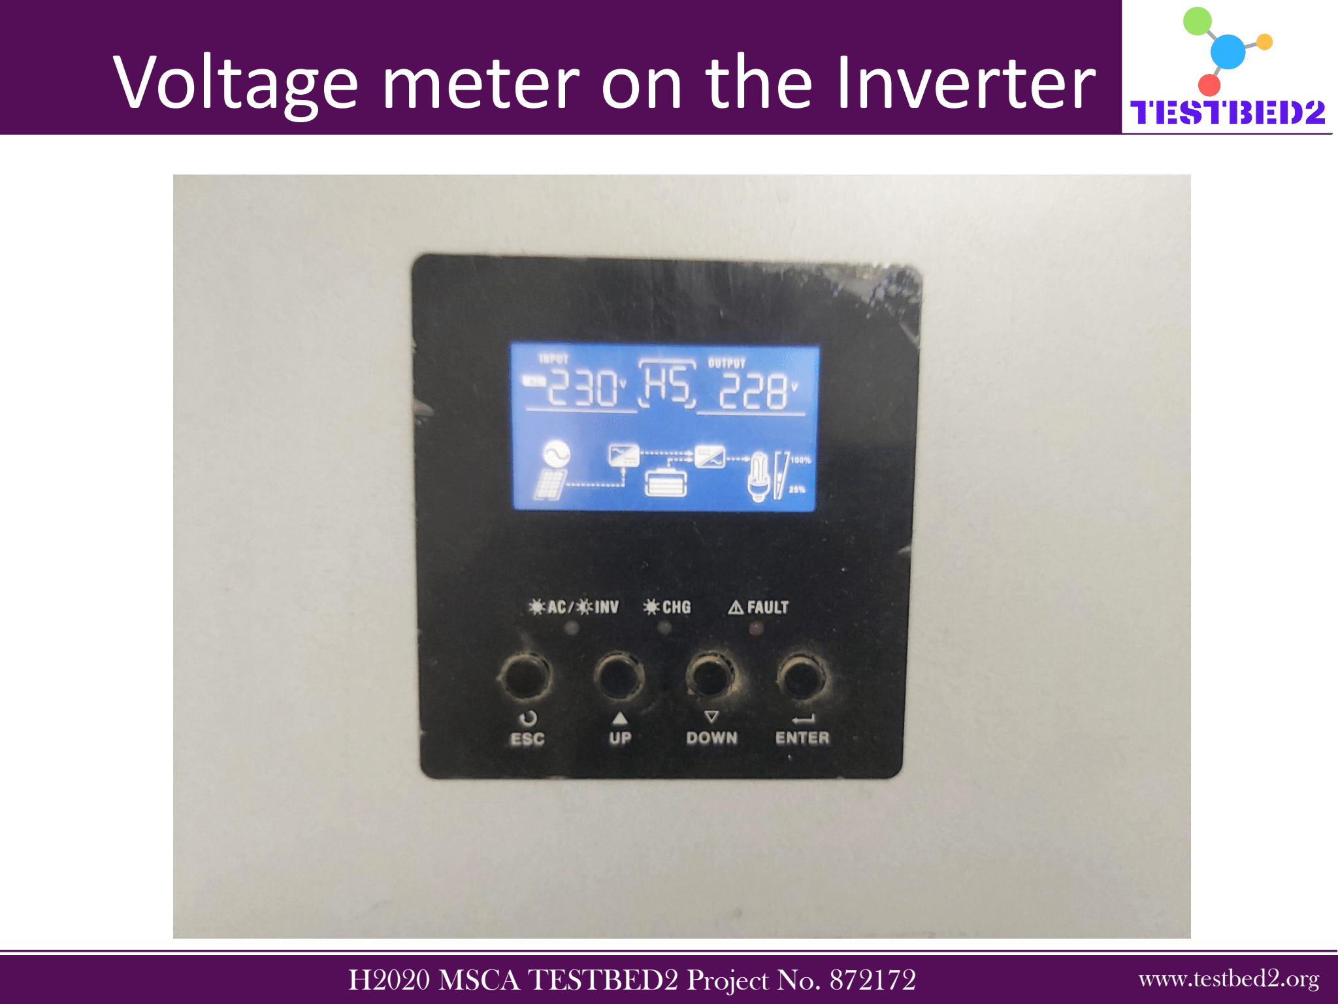
.

Slide 15
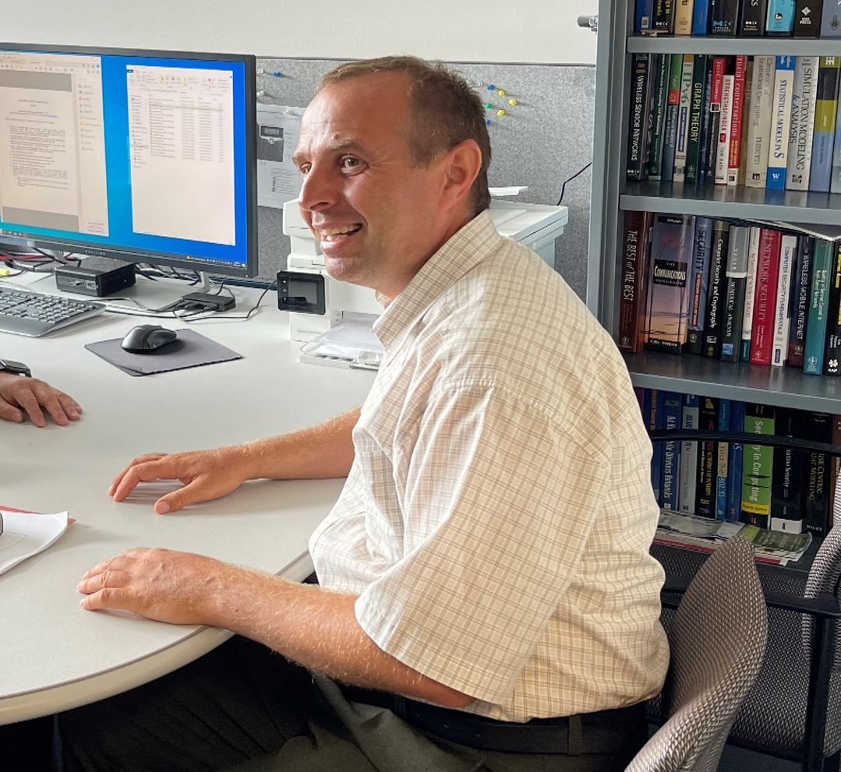
Prof. Dr. Ing. Goga Nicolae
Education:
Polytechnic University of Bucharest
B.S.E. Automatics and Computer science
M.S.E. Automatics and Computer science
Ph. D. Automatics and Computer science
Technical University of Eindhoven, the Netherlands
Ph. D. Mathematics and Computer Science
Secondment:
Nebraska-Lincoln University, USA
(August 2022)

Slide 16
Academic Experience
Teaching: Msc/Bachelor courses in Software Engineering, Networking,
Formal Languages, Formal Methods, Software Testing, Use of IT standards in Medical Informatics
Research: 1) Coordinator UPB, EU Eurica Project – Project for EU/Latin America university exchanges at Postdoc/PhD/Msc/Bachelor levels (www.eurica.nl);
2) Coordinator UPB: Ro - PN2 Project AIMMS (Ro-PN-II-PT-PCCA-2013-4-0685);
3) Coordinator UPB: EU Eurostar Project Premises (to start in March 2015);
Thesis supervission: Master and Bachelor levels
Double Degree Master for Software Engineering: Politehnica Bucharest and University of Groningen (http://www.rug.nl/masters/computing-science/programme) – Initiator and Coordinator UPB
Coauthored over 4 books. Helped write over 52 articles, where over 34 are international. He is also the holder of over 9 patents.

Slide 17


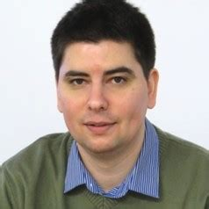
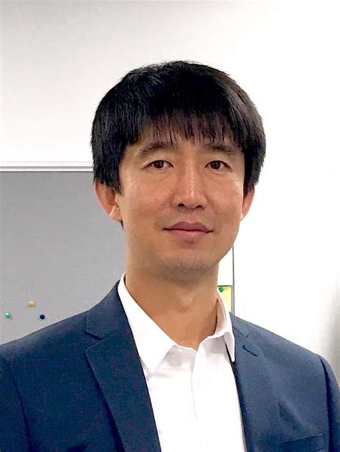
Conclusions
Secondment :
Prof. Conf. Valentin Robu
Prof. Conf. HongJian Sun
Notes:
The work in the secondments carried out was dedicated to WP2, → analysis in key management and authentication for SG and explored proposed solutions to merge schemes and perform joint processing where possible.
We discussed and analyzed the requirements defined in task 2.1.
Also we analyzed, whether the declared requirements are clear, are complete, not ambiguous or not contradictory to the business scenarios. \
Participation in the Summer School Durham on 7th and 8th June - Smart Energy and Decarbonisation.
Future work: We plan to continue our collaboration, by writing a paper describing the results of our research. We plan to work closely together, by organizing regular teleconferences, discuss issues and exchange thoughts.

Slide 18
Conclusions
Successful collaboration between partners at the secondments
Various testbeds are in work-in-progress
Future papers planned with CWI, Valentin Robu and BEIA for WP5
Potential PhD in the project based on WP5 for our secondees
Future work will include different collaborations in the project in order to asses a good understanding of the smart grid sector

Slide 19


Această fotografie de Autor necunoscut este licențiată în condițiile CC BY

